Slide 1
Simple Review
Back Tracking Paradigm
  A design technique, like divide-and-conquer.
  Useful for optimization problems and finding feasible solutions.
  Constraints
    Explicit Constraints
    Implicit Constraints
  General Method
    Identify space state tree → Generate problem state → Is solution state? → Is answer state?
    Searching in DFS way
N Queen problem
  Algorithm
  Bound function

Slide 2
Design and Analysis of Algorithms
Back-Tracking Algorithms Part II

Slide 3
Design and Analysis of Algorithms
Back-Tracking Algorithms
Topics:
Subset-sum problem

Slide 4
General Method of Back Tracking
BACKTRACKING
BACKTRACKING(n)
k←1;
while k>0 do
if there are unchecked X(k), X(k)∈T(X(1),…,X(k-1)) and B(X(1),…,X(k))=true
then if (X(1),…,X(k) is an answer）
then print (X(1),…,X(k))
if (k < n)
k←k+1
else
k←k-1
Construct solution in X(1:n), an answer is output immediately after it is determined.
T(X(1),...,X(k-1)) : returns all possible X(k) ,given X(1),…,X(k-1).
B(X(1),…,X(k)): returns whether X(1),…,X(k) satisfies the implicit constraints.

Slide 5
Recursive Method of Back Tracking
RECUSIVE-BACKTRACKING
RECURSIVE-BACKTRACKING( k )
for each X(k), X(k)∈T(X(1),…,X(k-1)) and B(X(1),…,X(k))=true do
if (X(1),…,X(k) is an answer）
then print (X(1),…,X(k))
if (k<n)
then call RECURSIVE-BACKTRACKING( k+1 )
Construct solution in X(1:n), an answer is output immediately after it is determined.
T(X(1),...,X(k-1)) : returns all possible X(k) ,given X(1),…,X(k-1).
B(X(1),…,X(k)): returns whether X(1),…,X(k) satisfies the implicit constraints.

Slide 6
Subset-sum problem
Given n+1 positive integers: w_{i} , 1≤i≤n, and M , Find all the subsets of W={w_{i}} , of which the summary equals to M.
  E.g. n＝4, (w_{l}，w₂，w₃，w₄)＝(11，13，24，7)，M＝31
    The expected subsets are (11，13，7) and (24，7).
The form of solution
  A solution of subset-sum problem is defined as an n-tuple (x₁，x₂，… ，x_{n}), where x_{i}∈{0，1}, 1≤i≤n. If w_{i} is included in the subset, then x_{i}＝1, otherwise x_{i}＝0.
    The above answers can be defined as （1，1，0，1）and （0，0，1，1）。

Slide 7
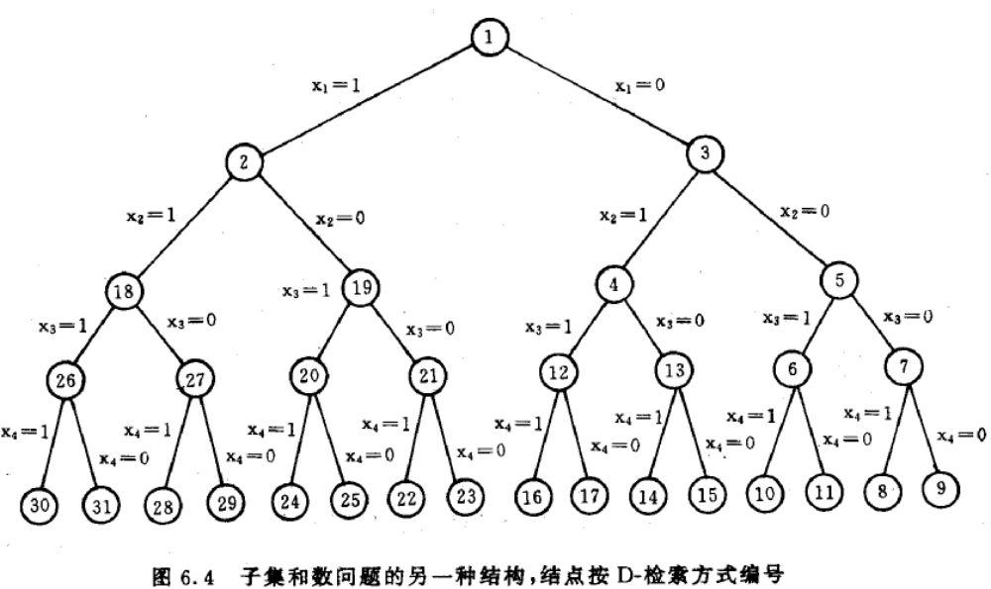
State space tree for Subset-sum problem
It is easy to determine X(i)/generate problem state.
The key is the bound function.

Slide 8

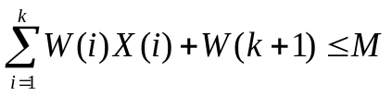
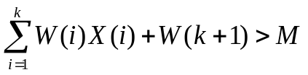
Bound function
A simple choice is : B(X(1),…, X(k))=true
iff
Sort W(i) in increasing order.
Bound function is: B(X(1),…, X(k))=true
iff and
if W(i) are sorted in increasing order, and if
X(1), …, X(k) will never result in an answer.

Slide 9
Recursive Method of Back Tracking
Sort W(i) in increasing order.
Bound function is: B(X(1),…, X(k))=true
iff and
RECUSIVE-BACKTRACKING
RECURSIVE-BACKTRACKING( k )
for each X(k), X(k)∈T(X(1),…,X(k-1)) and B(X(1),…,X(k))=true do
if (X(1),…,X(k) is an answer）
then print (X(1),…,X(k))
if (k<n)
then call RECURSIVE-BACKTRACKING( k+1 )
{0,1}
Construct solution in X(1:n), an answer is output immediately after it is determined.
T(X(1),...,X(k-1)) : returns all possible X(k) ,given X(1),…,X(k-1).
B(X(1),…,X(k)): returns whether X(1),…,X(k) satisfies the implicit constraints.

Slide 10

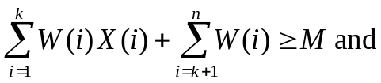
Back Tracking Algorithm for Subset-Sum
Sort W(i) in increasing order.
Bound function is: B(X(1),…, X(k))=true
iff and
Original Recursive Algorithm:
ORIGINAL-SUMOFSUB
ORIGINAL-SUMOFSUB(k)
X(k)←1
if
then print(X(j),j←1 to k)
else if
then call SUMOFSUB(k+1)
X(k)←0
if
then call SUMOFSUB(k+1)

Slide 11
Back Tracking Algorithm for Subset-Sum
Sort W(i) in increasing order.
Bound function is: B(X(1),…, X(k))=true
iff and
SUMOFSUB
SUMOFSUB(s,k,r)
X(k)←1
if s+W(k)=M
then print(X(j),j←1 to k)
else if s+W(k)+W(k+1) ≤ M
then call SUMOFSUB(s+W(k),k+1,r-W(k))
if s+r-W(k) ≥ M and s+W(k+1) ≤ M
then X(k)←0
call SUMOFSUB(s,k+1,r-W(k))

Slide 12
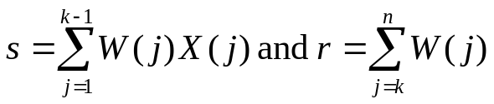
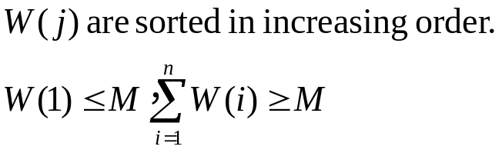
Back Tracking Algorithm for Subset-Sum
Sort W(i) in increasing order.
Bound function is: B(X(1),…, X(k))=true
iff and
SUMOFSUB
SUMOFSUB(s,k,r)
X(k)←1
if s+W(k)=M
then print(X(j),j←1 to k)
else if s+W(k)+W(k+1) ≤ M
then call SUMOFSUB(s+W(k),k+1,r-W(k))
if s+r-W(k) ≥ M and s+W(k+1) ≤ M
then X(k)←0
call SUMOFSUB(s,k+1,r-W(k))
When called, X(1),X(2),…X(k-1) have been determined.

Slide 13
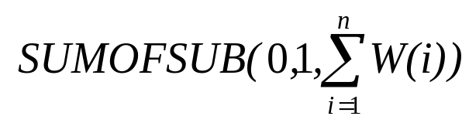
Back Tracking Algorithm for Subset-Sum
Sort W(i) in increasing order.
Bound function is: B(X(1),…, X(k))=true
iff and
SUMOFSUB
SUMOFSUB(s,k,r)
X(k)←1
if s+W(k)=M
then print(X(j),j←1 to k)
else if s+W(k)+W(k+1) ≤ M
then call SUMOFSUB(s+W(k),k+1,r-W(k))
if s+r-W(k) ≥ M and s+W(k+1) ≤ M
then X(k)←0
call SUMOFSUB(s,k+1,r-W(k))
Initial call:

Slide 14
Back Tracking Algorithm for Subset-Sum
Sort W(i) in increasing order.
Bound function is: B(X(1),…, X(k))=true
iff and
SUMOFSUB
SUMOFSUB(s,k,r)
X(k)←1
if s+W(k)=M
then print(X(j),j←1 to k)
else if s+W(k)+W(k+1) ≤ M
then call SUMOFSUB(s+W(k),k+1,r-W(k))
if s+r-W(k) ≥ M and s+W(k+1) ≤ M
then X(k)←0
call SUMOFSUB(s,k+1,r-W(k))
Check left son(X(k)=1).

Slide 15
Back Tracking Algorithm for Subset-Sum
Sort W(i) in increasing order.
Bound function is: B(X(1),…, X(k))=true
iff and
SUMOFSUB
SUMOFSUB(s,k,r)
X(k)←1
if s+W(k)=M
then print(X(j),j←1 to k)
else if s+W(k)+W(k+1) ≤ M
then call SUMOFSUB(s+W(k),k+1,r-W(k))
if s+r-W(k) ≥ M and s+W(k+1) ≤ M
then X(k)←0
call SUMOFSUB(s,k+1,r-W(k))
Print the answer once found.
No recursive call after finding an answer.

Slide 16

Back Tracking Algorithm for Subset-Sum
Sort W(i) in increasing order.
Bound function is: B(X(1),…, X(k))=true
iff and
?do not check
Initail:
SUMOFSUB
SUMOFSUB(s,k,r)
X(k)←1
if s+W(k)=M
then print(X(j),j←1 to k)
else if s+W(k)+W(k+1) ≤ M
then call SUMOFSUB(s+W(k),k+1,r-W(k))
if s+r-W(k) ≥ M and s+W(k+1) ≤ M
then X(k)←0
call SUMOFSUB(s,k+1,r-W(k))
If the bound function is satisfied, do recursive call.
“s+r ≥ M” is satisfied at each call.

Slide 17
Back Tracking Algorithm for Subset-Sum
Sort W(i) in increasing order.
Bound function is: B(X(1),…, X(k))=true
iff and
SUMOFSUB
SUMOFSUB(s,k,r)
X(k)←1
if s+W(k)=M
then print(X(j),j←1 to k)
else if s+W(k)+W(k+1) ≤ M
then call SUMOFSUB(s+W(k),k+1,r-W(k))
if s+r-W(k) ≥ M and s+W(k+1) ≤ M
then X(k)←0
call SUMOFSUB(s,k+1,r-W(k))
Check right son(X(k)=0).

Slide 18
Back Tracking Algorithm for Subset-Sum
Sort W(i) in increasing order.
Bound function is: B(X(1),…, X(k))=true
iff and
SUMOFSUB
SUMOFSUB(s,k,r)
X(k)←1
if s+W(k)=M
then print(X(j),j←1 to k)
else if s+W(k)+W(k+1) ≤ M
then call SUMOFSUB(s+W(k),k+1,r-W(k))
if s+r-W(k) ≥ M and s+W(k+1) ≤ M
then X(k)←0
call SUMOFSUB(s,k+1,r-W(k))
? why not use “k>n” to stop recursion
At each call, s<M, and s+r≥M, so r > 0, it is impossible that k be greater than n。

Slide 19
Case study
(w₁, w₂, w₃, w₄ ) = ( 5, 10 , 15, 20 ) ; M = 25
SUMOFSUB(s,k,r)
X(k)←1
if s+W(k)=M
then print(X(j),j←1 to k)
else if s+W(k)+W(k+1) ≤ M
then call SUMOFSUB(s+W(k),k+1,r-W(k))
if s+r-W(k) ≥ M and s+W(k+1) ≤ M
then X(k)←0
call SUMOFSUB(s,k+1,r-W(k))
s,k,r
0,1,50
x₁=1
x₁=0
5,2,45
0,2,45
x₂=1
x₂=0
x₂=0
(1,0,0,1)
5,3,35
10,3,35
0,3,35
(0,1,1,0)
x₃=0
x₃=1
5,4,20
B
x₄=1
A

